Slide 1
Resources and feedback

Slide 2

This part/session is for
Any question or feedback
wrt NAF Framework ?

Slide 3
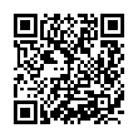
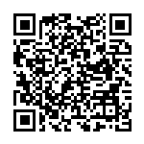
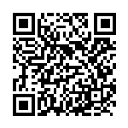
Resources
NAF Framework
NAF Framework presentations
NAF Slack
https://reference.networkautomation.forum/Framework/Framework/
https://reference.networkautomation.forum/Framework/Presentations/
https://networkautomationfrm.slack.com/archives/C082G6VGZHP

Slide 4
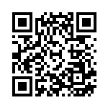
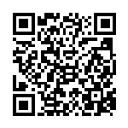
Additional resources
Designing Network
Automation at Scale
NAF Network Automation
Solution Wizard
A comprehensive guide to designing scalable, reliable, and maintainable network automation systems
This application helps you apply the Network Automation Forum's NAF to your automation projects.
https://designingnetworkautomation.com/
By Christian Adell
https://naf-framework-solution-wizard.streamlit.app/
By Claudia de Luna

Slide 5
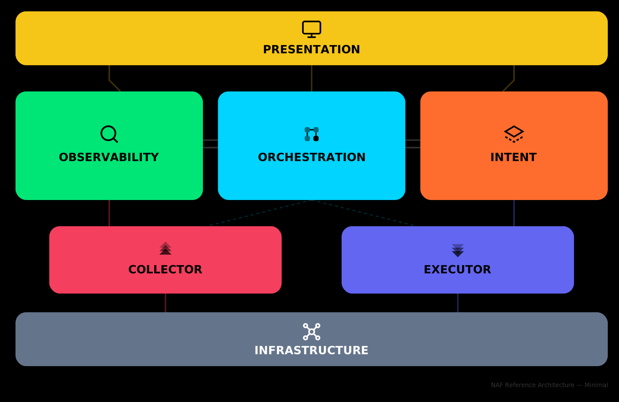

NAF Framework

Slide 6
Up to the BoF

Slide 7
How many building block instances can you have?
One
Many
All of the above

Slide 8
Where does PyATS/NUTS fit?
Observability
Orchestration
Collector
Executor
Intent
All of the above

Slide 9
Where is AI fitting in?
Observability
Orchestration
Collector
Executor
Intent
All of the above

Slide 10
How to apply network validation with the framework?
Intent
Observability
Executor
Collector

